Slide 1
Seamless customer experience

Slide 2
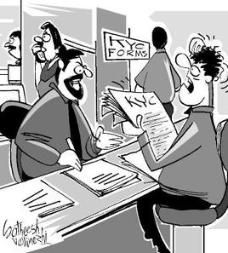
Current Situation
Current Process of KYC
Physical copies of attested documents required
Manual, slow and resource intensive.
Spanning over multiple days.
Each department sees the customer as an exclusive customer.
Re-KYC need another personal handover of documents.

Slide 3
Solution
Automating KYC
A decentralised, fast, efficient, streamlined and automated KYC process for new and existing Customers
OCR for Reading Documents.
Face Recognition for identification and authentication.
Distributed Ledger Technology for storing IDs

Slide 4
Process
A New Customer
Request for ID & Documents
Uploads the ID & Documents
Identify the Face using Facial Recognition Engine
No
Verify the uploaded documents?
Prefill the Onboarding Form using OCR
Yes
Generate Report
Submit to DLT

Slide 5
Process
Buying New Product
Buy Additional Product
Make an application
Looks for customer ID
Query to DLT
Yes
Fetch Documents

Slide 6
Process
Change IN Circumstances
Triggers for Change in Circumstances
Request for updated ID & Documents
Logs in and Submits Change
Identify the Face using Facial Recognition Engine
No
Verify the uploaded change?
Prefill the Form using OCR
Yes
Generate Report
Submit to DLT

Slide 7
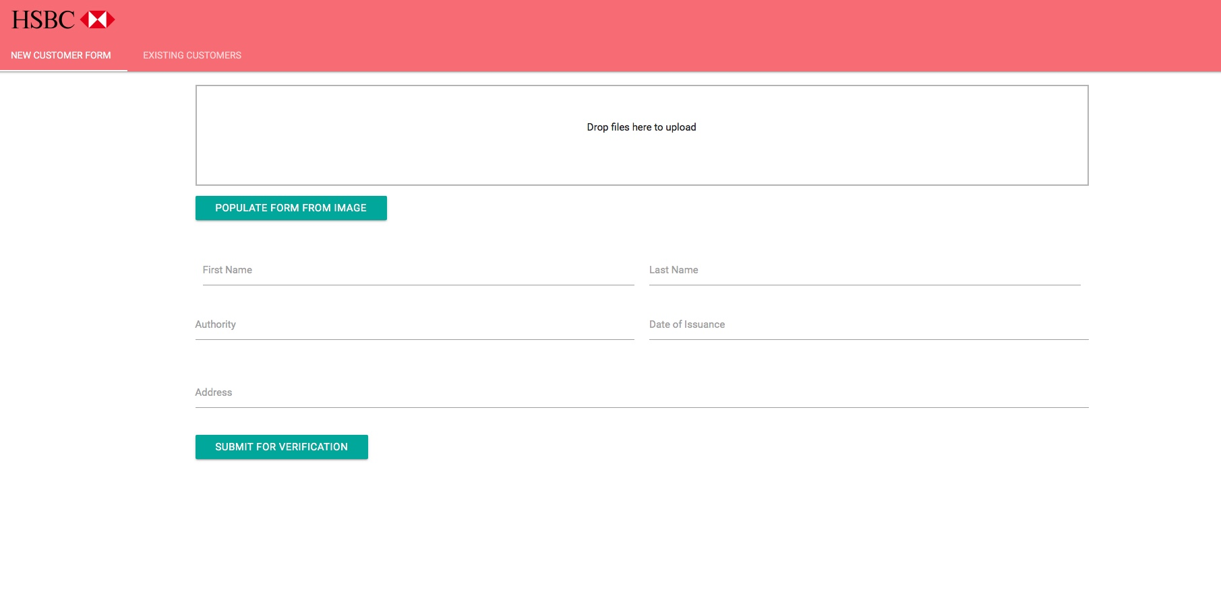
Demo
A simple working demo

Slide 8
Benefits
the technology explained
Automates KYC
Fast access
Multiple products by multiple departments.
Multiple nodes
Less risk
No single point of failure
History of uploads and verifications

Slide 9
In Progress
Improvements still in development
Details of customer’s products and the interacting RMs
Extra security measures for customers of Sanctioned countries.

Slide 10
Questions
And feedback

